Slide 1
Auto-Encoding Variational Bayes (VAE)
Diederik P. Kingma Universiteit van Amsterdam 2014 ICLR

Slide 2
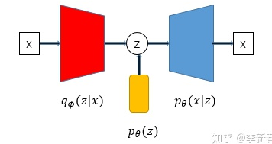
1
Scenario & Problem

Slide 3
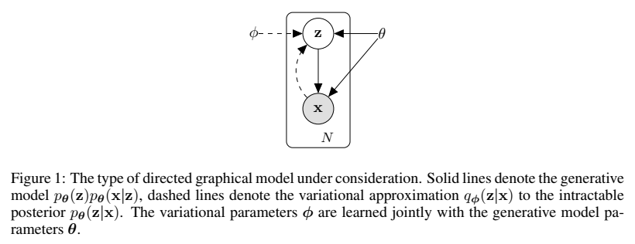
1
Scenario & Problem

Slide 4
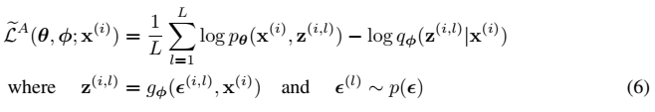


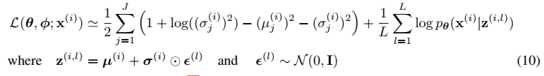
1
Experiment

Slide 5
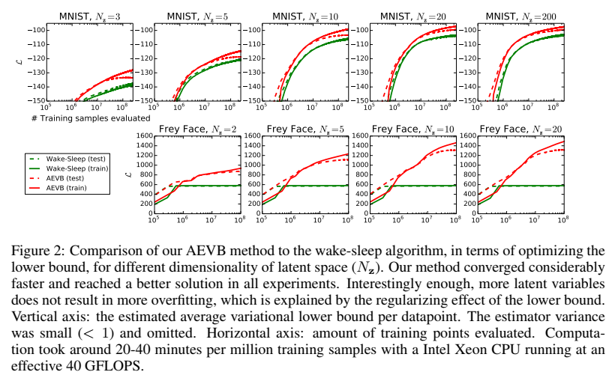
1
Experiment

Slide 6
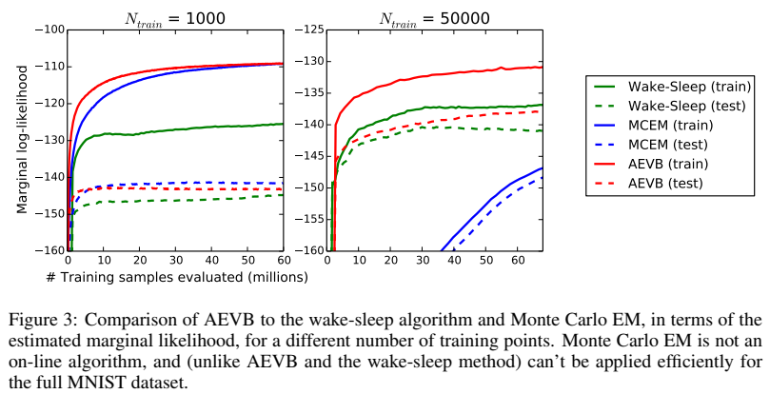
1
Experiment

Slide 7
1
Experiment

Slide 8
4
Conclusion

